Slide 1
Prediction of Chronic Kidney Diseases using Machine Learing ANN & KNN Technique
Presented By:
Prateek Gupta
Student, Department of Computer Science,GGSIPU-ADGITM,New Delhi
Authors: Prateek Gupta
, AKULA NAVEEN, LAMMATHA SUNEETHA

Slide 2
Contents:
ABSTRACT
INTRODUCTION
SYSTEM ANALYSIS
FUNCTIONAL COMPONENTS
SCREENSHOTS
RESULT & DISCUSSSION
CONCLUSON

Slide 3
Abstract
Chronic Kidney Disease (CKD) is one of the most widespread illnesses in the United States. Recent statistics show that twenty-six million adults in the United States have CKD and million others are at increased risk.
Clinical diagnosis of CKD is based on blood and urine tests as well as removing a sample of kidney tissue for testing. Early diagnosis and detection of kidney disease is important to help stop the progression to kidney failure. Data mining and analytics techniques can be used for predicting CKD by utilizing historical patient’s data and diagnosis records.
Chronic Kidney Disease prediction is one of the most important issues in healthcare analytics. The most interesting and challenging tasks in day to day life is prediction in medical field. In this paper, we employ some machine learning techniques for predicting the chronic kidney disease using clinical data.
Chronic kidney disease (CKD), also known as chronic renal disease. Chronic kidney disease involves conditions that damage your kidneys and decrease their ability to keep you healthy.

Slide 4
Introduction
Machine learning has been used to detect CKD and its progression using labwork data. While this is potentially useful for those patients that find themselves getting bloodwork done at routine checkups or in tandem with other health-related issues, it poses two problems: first, it requires individual patients to have regular lab work done, and second, it does nothing to predict the disease at the population level. The Centers for Disease Control (CDC) recognize chronic kidney disease as a public health concern that requires population-level surveillance and prevention.
However, the hyperlocal surveillance of CKD is difficult and costly. This limits our ability to effectively target campaigns to prevent CKD and its progression. In order to predict hyperlocal disease prevalence, the model presented in this paper uses readily available Census Bureau and CDC data on known and hypothesized risk factors with stochastic gradient descent to better identify census tracts where aggressive public health campaigns and healthcare initiatives can positively affect the early detection and treatment of CKD. Further investigation into this model may also give insight into potential risk factors.

Slide 5
The Causes of CKD
The two main causes of chronic kidney disease are diabetes and high blood pressure, which are responsible for up to two-thirds of the cases.
Diabetes happens when your blood sugar is too high, causing damage to many organs in your body, including the kidneys and heart, as well as blood vessels, nerves, and eyes. High blood pressure, or hypertension, occurs when the pressure of your blood against the walls of your blood vessels increases.
If uncontrolled, or poorly controlled, high blood pressure can be a leading cause of heart attacks, strokes, and chronic kidney disease. Also, chronic kidney disease can cause high blood pressure.
Notes:
Multiple hidden layer can be used depending on the need. We have used only 1 hidden layer.

Slide 6
Other conditions that affect the kidneys are:
• Glomerulonephritis, a group of diseases that cause inflammation and damage to the kidney’s filtering units. These disorders are the third most common type of kidney disease.
• Inherited diseases, such as polycystic kidney disease, which causes large cysts to form in the kidneys and damage the surrounding tissue.
• Malformations that occur as a baby develops in its mother’s womb. For example, a narrowing may occur that prevents normal outflow of urine and causes urine to flow back up to the kidney. This causes infections and may damage the kidneys.
• Lupus and other diseases that affect the body’s immune system.
• Obstructions caused by problems like kidney stones, tumors, or an enlarged prostate gland in men.
• Repeated urinary infections.

Slide 7
Who Is at Risk?
• Diabetes. Diabetes is the leading cause of CKD. If you have diabetes, talk with your doctor about how to keep your blood glucose as close to normal as possible to ensure your diabetes is under control.
• Hypertension. Hypertension, also called high blood pressure, is the second-highest cause of CKD. Keep your blood pressure under control. A number of effective medications are available to help you with this task. Your doctor will help you to determine which medication is right for you.
• Cardiovascular disease. In addition to hypertension, other diseases of the heart and blood vessels may increase your risk for kidney disease. People who have had heart attacks or strokes, congestive heart failure, coronary artery disease, or peripheral vascular disease need to be monitored carefully for kidney problems.
• Family history of kidney disease. Some kidney diseases are genetic. People with a mother, father, brother, or sister who has had a kidney disease are more likely to develop problems with their kidneys.
• Age. People 60 years and older are at a higher risk for developing CKD.
• Race. People belonging to certain ethnic groups, such as First Nations (Canadian aboriginal peoples) and Pacific Islanders, are at a higher risk for developing this disease.

Slide 8
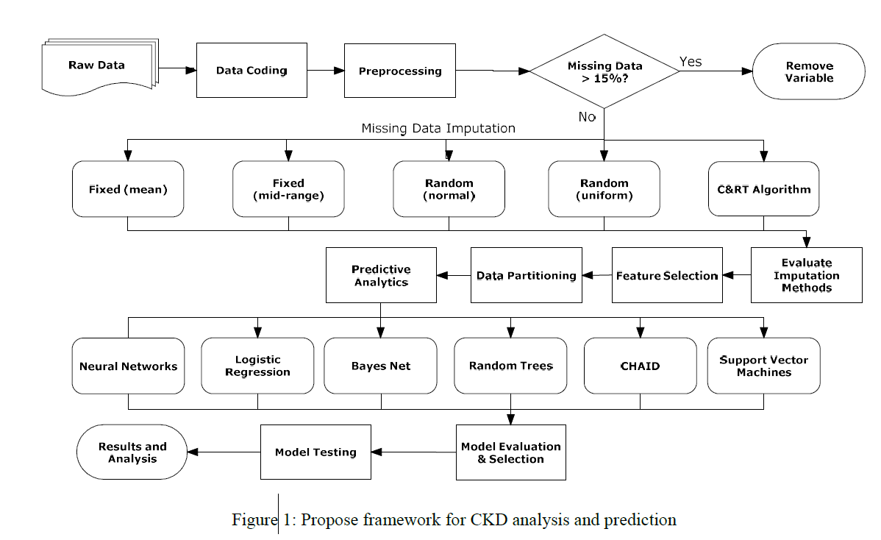

Slide 9
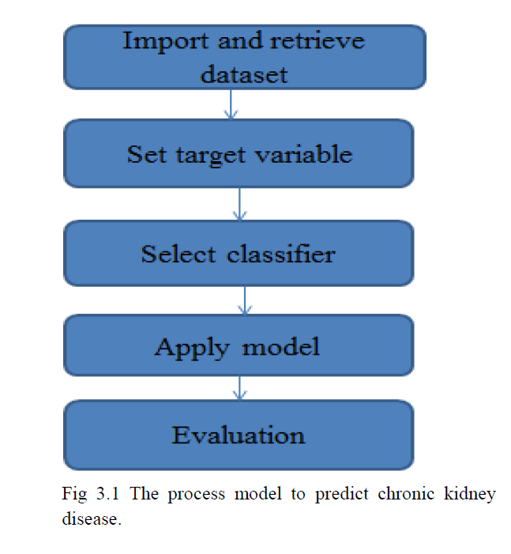

Slide 10
ABOUT THE PROJECT Existing System Chronic Kidney Disease (CKD) is a major medical problem and can be cured if treated it in the early stages. Usually, people are not aware that medical tests, we take for different purposes could contain valuable information concerning kidney diseases. Proposed System The work proposed here uses three classification techniques to predict the presence of chronic kidney disease in humans. The classifiers used are Support vector machine and KNN classifier The data set for chronic kidney disease was gathered and applied on each classifier to predict the disease and the performance of the classifier is evaluated based on accuracy, precision and F measure. Architecture of Predictive Data Mining: Proposed Approach. The working of the architecture is as follows: The dataset for CKD patients have been collected and fed into the classifier named SVM and KNN

Slide 11
Disadvantages of system The existing prediction system for chronic kidney disease is fine with some limitations. Below is the table shown, describing the worked done for prediction and detection of various kidney diseases. A new CKD prediction system is still the need. A decision support system for chronic kidney disease is still the need for early prediction, as not much work is done for the same. The list of risk factors above is a reflection of the results of several separate studies. Data Pre-Processing The CDC data was paired down to include only tract-level data. It was then pivoted so that each row represents a census tract and each column a variable. Since the tract-level CDC data is not regularly updated, all disease variables other than chronic kidney disease were dropped from the dataset in order to avoid fitting the model to data that could not be easily attained beyond the 2015 data.

Slide 12
Follow the following steps to process your Data
• Import the Libraries
• Importing the dataset
• Taking care of Missing Data
• Label encoding
• One Hot Encoding
• Feature Scaling
• Splitting Data into Train and Test
PREDICTIVE MODELING
To predict the rate of chronic kidney disease (CKD) among adults, a series of linear regression and ensemble methods were evaluated (see table below). To assess generalizability, the dataset was split into a training and test set.

Slide 13
Statistical Modelling
Assessment of Current Diagnosis Technique in Literature
As mentioned before, Albuminuria (Al) is a pathological condition in which the protein, albumin, is abnormally present in urine. Persistent Albuminuria suggests some level of kidney damage. Another important factor to measure the severity of CKD is GFR which is estimated by Serum Ceratitine (sc) in combination of age, sex, ethnic origin and body size.
Model with Numerical Predictors
When fitting a logistic regression model considering all nominal and numerical predictors, the algorithm does not converge due to perfect separation where the response separates a combination of categorical predictor variables completely
Model Selection
As there is no ’best’ model and the model with six predictors in Section 4.2 is chosen by randomly selecting one of the predictors among highly correlated ones, a more methodological way to assess the explanatory and predictive power of predictors is to conduct model selection.

Slide 14
Functional components of the project
Data Mining Techniques
1. Support Vector Machines
Support Vector Machines (SVM) is a powerful, state-of-the-art algorithm based on linear and nonlinear regression.
Oracle Data Mining implements SVM for binary and multiclass classification.
2. K-nearest neighbor Classification
In pattern recognition, the K-Nearest Neighbor algorithm (K-NN) is a non-parametric method used for classification and regression.
In both cases, the input consists of the K closest training examples in he feature space. K-NN is a type of instance-based learning.
In KNN Classification, the output is a class membership.
Classification is done by a majority vote of neighbours.

Slide 15
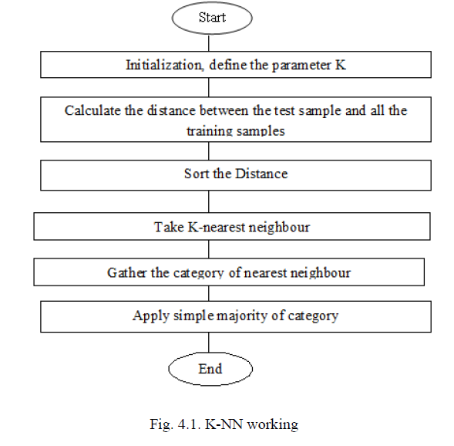

Slide 16
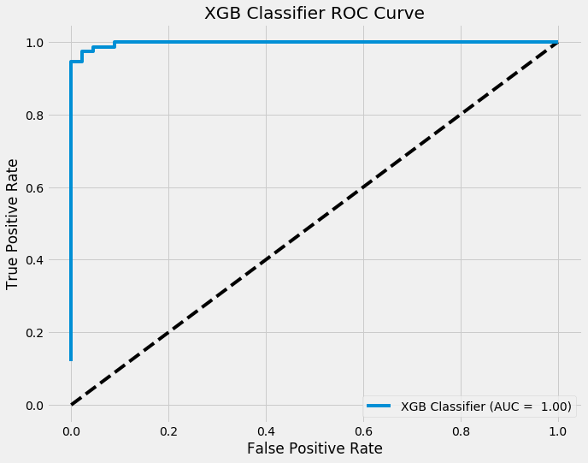
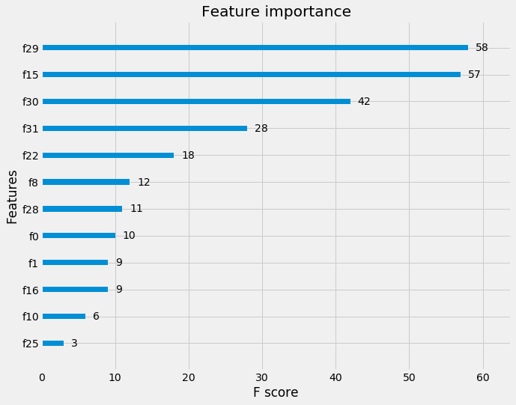
OUTPUT SCREENS SCREENSHOTS

Slide 17
RESULT AND DISCUSSION
The machine learning methods described are trained to predict the chronic kidney disease. Two classifier methods are used in this decision tree and naive bayes . The experiments are constructed on R tool. In this work , the performance is measured by sensitivity, specificity and accuracy described as follows.
Accuracy (ACC) is the overall success rate of the classifier defined as :
ACC = (TP + TN) / (TP + FP + TN + FN)
With the help of True Positive (TP) and True Negative (TN) the performance of the classifications model is evaluated. The machine learning techniques used are trained and tested separately in this work. The 10-fold cross validation is used to train and test the machine learning models in this work and the average results.
The decision tree method and naive bayes method the accuracy of decision tree method is relatively higher than the naive bayes method. The decision tree method can be adopted since it has the accuracy of 99.25% in prediction of chronic kidney disease.

Slide 18
CONCLUSION
As we have already seen the applications of data mining and machine learning in medical sector. In this paper, a new decision support system is implemented for prediction of CKD.
Although the classifiers worked efficiently in prediction of other diseases also. In this paper, Chronic Kidney Disease is predicted using two different classifiers and a comparative study of their performance is done.
From the analysis we found that, out of two classifiers SVM and KNN, KNN classifier performed better than the other. The rate of prediction of CKD is improved.
As we can see in the map generated below, which depicts the rates of CKD at a tract-level within two cities in northern Indiana, this information can allow us to focus limited resources not only on specific counties or cities, but to also narrow campaigns to very specific areas within cities

Slide 19
SCOPE FOR FURTHER DEVELOPMENT
There are other possible evolutionary techniques that may be used to improve results of the proposed classifiers. In this paper, SVM and KNN are applied to detect CKD. We can also evaluate and compare the performance of the used classifiers with other existing classifiers. CKD early detection helps in timely treatment of the patients suffering from the disease and also to avoid the disease from getting worse. Early prediction of the disease and timely treatment are the need for medical sector. New classifiers can be used and their performance can be evaluated to find better solutions of the objective function in future work.
SCOPE OF ENHANCEMENT
Some people suffering with severe cases of COVID-19 are showing signs of kidney damage, even those who had no underlying kidney problems before they were infected with the coronavirus. Early reports say that up to 30% of patients hospitalized with COVID-19 in China and New York developed moderate or severe kidney injury. Reports from doctors in New York are saying the percentage could be higher.

Slide 20
THANK YOU !!!

